Slide 1

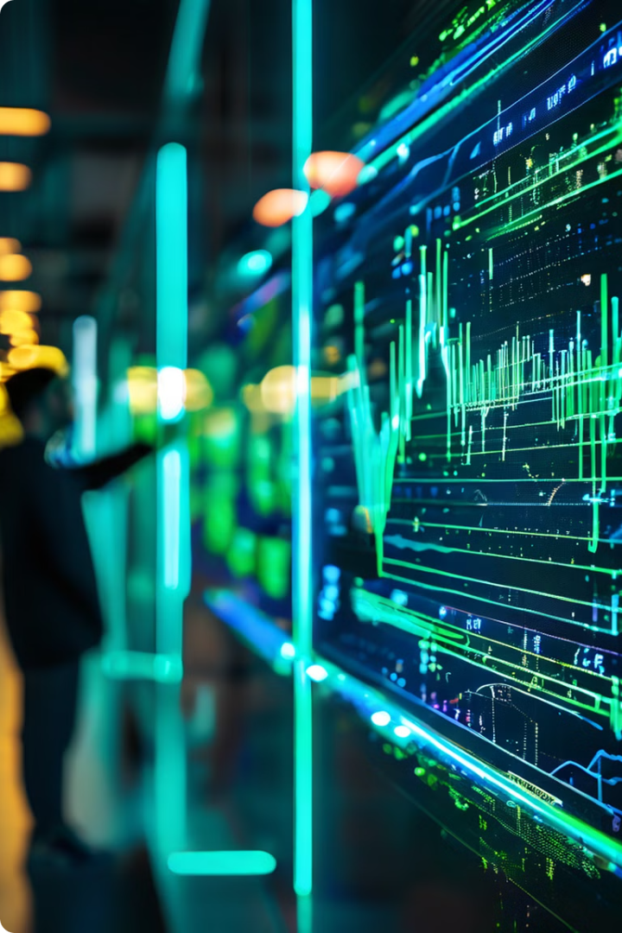

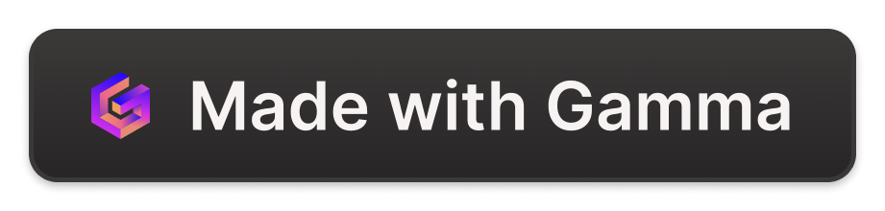
Introduction to AI: Training and Inference
This presentation will explain the essential concepts of AI training and inference. It will then discuss the roles of GPUs and neural engines in these processes. We will also consider the advantages and challenges of using these technologies.
by Juvenile teachers

Slide 2
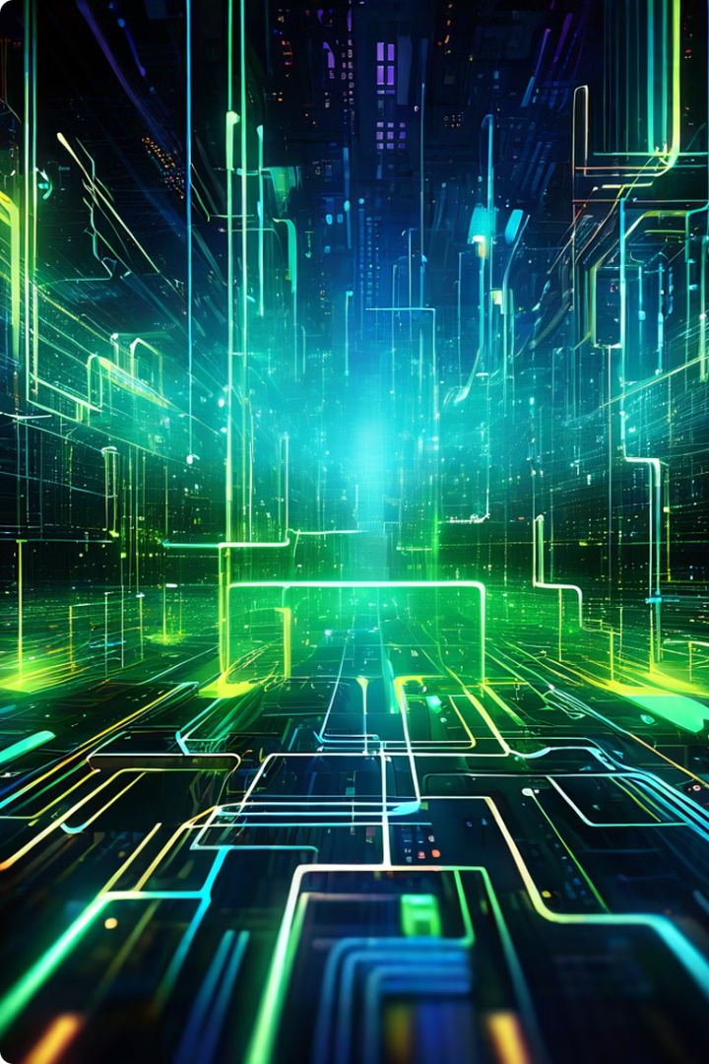
What is Training in AI?
AI training involves exposing a machine learning model to large datasets. This process allows the model to learn patterns and relationships within the data. By adjusting its internal parameters, the model becomes better at predicting outcomes and performing tasks.
1
Data Preparation
The first step in AI training is to gather and prepare data. This involves cleaning, formatting, and labeling the data to ensure it is suitable for training.
2
Model Selection
Selecting the appropriate machine learning model is crucial for achieving optimal results. Different models excel at different tasks.
3
Parameter Optimization
Training involves adjusting the model's parameters to minimize errors and improve its performance. This is done using optimization algorithms.
4
Evaluation and Validation
The trained model needs to be evaluated on unseen data to assess its generalization ability and ensure it performs well in real-world scenarios.

Slide 3




What is Inference in AI?
AI inference involves using a trained machine learning model to make predictions or decisions based on new input data. This process is typically performed in real-time and requires efficient hardware and software.
Model Deployment
Once a model is trained, it needs to be deployed on a suitable platform or device where it can receive inputs and generate outputs.
Input Data
New data is fed into the trained model. This data must be in the same format and structure as the data used for training.
Prediction
The model uses its learned knowledge to process the input data and generate a prediction, decision, or output.

Slide 4
The Role of GPUs in AI Training
GPUs (Graphics Processing Units) are specialized processors designed for parallel computation. This makes them particularly well-suited for the demanding computational tasks involved in AI training.
Parallel Processing
Memory Bandwidth
Optimized Libraries
GPUs can perform thousands of calculations simultaneously, enabling faster training times compared to traditional CPUs.
GPUs have high memory bandwidth, allowing them to quickly access and process the massive amounts of data required for training.
Specialized libraries like CUDA and OpenCL provide optimized frameworks for developing and running AI training algorithms on GPUs.

Slide 5

The Role of Neural Engines in AI Inference
Neural engines are specialized hardware units optimized for performing AI inference tasks. They are typically integrated into mobile devices and edge computing platforms.
Feature
Neural Engine
GPU
Power Consumption
Low
High
Latency
Low
Medium
Performance
Optimized for Inference
Optimized for Training and Inference

Slide 6





Advantages of GPU and Neural Engine Utilization
Using GPUs and neural engines for AI training and inference offers several advantages. These technologies accelerate performance, reduce costs, and improve the efficiency of AI models.
Speed
Cost Reduction
Power Efficiency
Scalability
GPUs and neural engines significantly speed up training and inference processes, allowing for faster model development and deployment.
GPUs and neural engines can be scaled to handle massive datasets and complex AI models, enabling the development of advanced AI applications.
Efficient hardware reduces the computational resources needed for AI, leading to lower energy consumption and overall cost savings.
Neural engines are specifically designed for low-power inference, making them ideal for mobile and edge devices with limited battery life.

Slide 7

Challenges and Limitations of GPU and Neural Engine Usage
While GPUs and neural engines offer substantial benefits, they also come with certain challenges and limitations. These include cost considerations, technical expertise requirements, and potential hardware limitations.
Cost
1
High-performance GPUs and specialized neural engines can be expensive, especially for businesses and researchers with limited budgets.
2
Technical Expertise
Developing and deploying AI models on these platforms requires specialized skills and knowledge of parallel computing and hardware optimization.
Hardware Limitations
3
GPUs and neural engines have specific limitations in terms of memory capacity, processing power, and compatibility with different software and platforms.

Slide 8
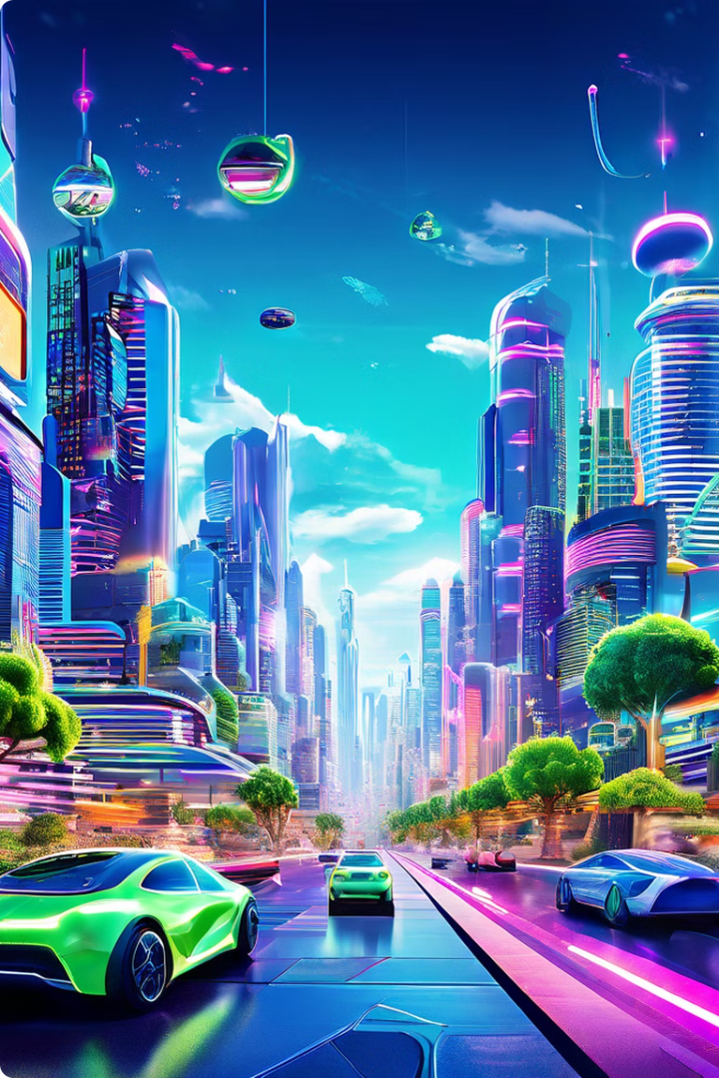
Conclusion: The Future of AI Training and Inference
The use of GPUs and neural engines is revolutionizing AI training and inference. As these technologies continue to advance, we can expect further improvements in speed, efficiency, and accessibility, making AI more powerful and impactful in various domains.
Advancements in Hardware
Ongoing research and development in hardware will lead to even more powerful and efficient GPUs and neural engines, further accelerating AI training and inference.
Software Optimization
Software frameworks and libraries will continue to evolve, providing better tools and techniques for optimizing AI models and leveraging hardware capabilities.
AI Applications
The widespread adoption of AI will drive innovation across industries, leading to new and groundbreaking applications in areas such as healthcare, transportation, and manufacturing.

